Slide 1
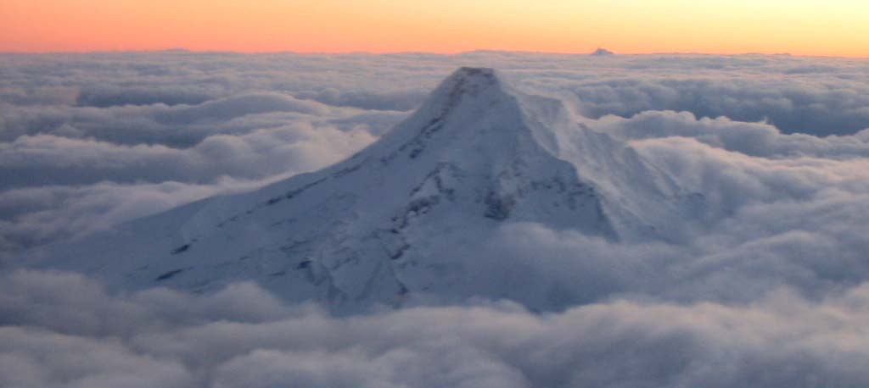
Ends Not Means:
The Axiology* of Place-Based Education
Charles “Kip” Ault
Professor Emeritus, Lewis & Clark Graduate School of Education and Counseling, Portland, OR, USA
ault-kip.com
*Axiology: the study of what things have value.

Slide 2
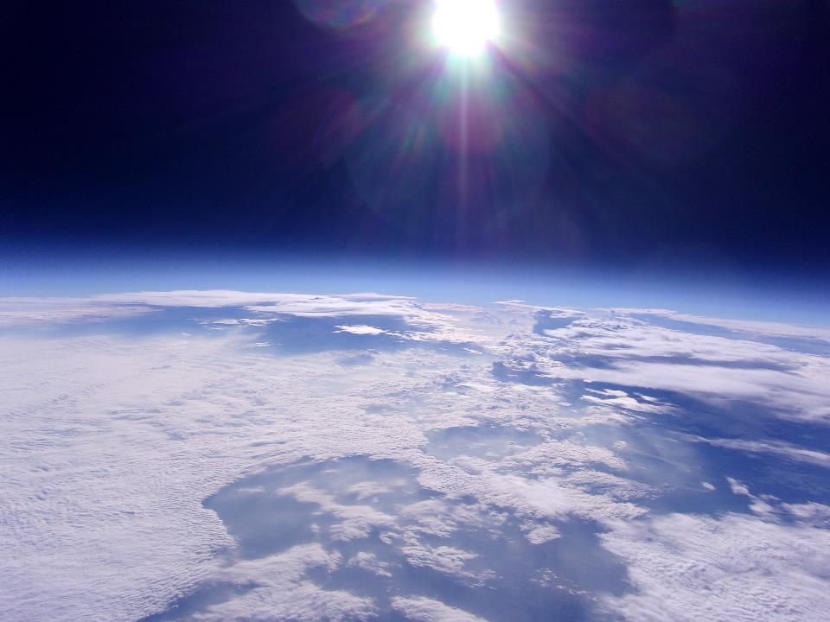
The Ends Valued by
Place-based (Geoscience) Education
Caring for the landscape’s capacity to sustain communities
2. Attaining identity as a beloved member of the community
3. Achieving an understanding of the science needed to improve the community
For example, students working with artists and scientists to enhance local geotourism

Slide 3
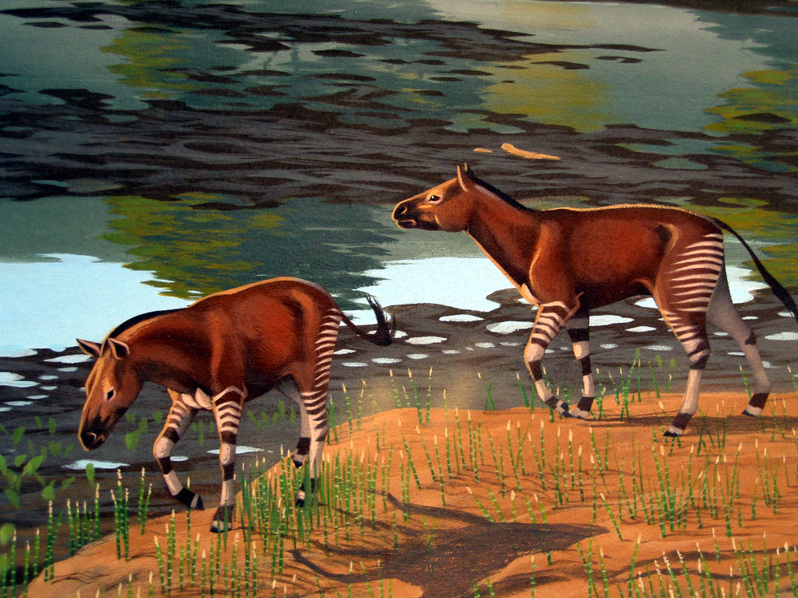
The Paleogene to Neogene story of changing climate and the evolutionary responses of its inhabitants lies embedded in the rocks and fossils of north central Oregon.
The “Horse Fossil Study Kit,” created at the John Day Fossil Beds National Monument decades ago, tells this story.

Slide 4
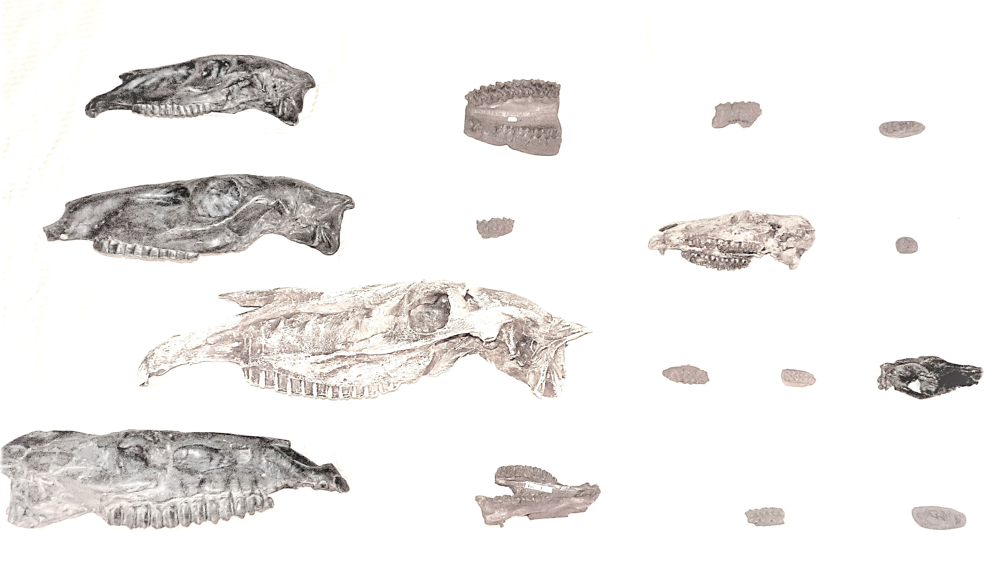
Four sets of skull, mandible and tooth fossils to associate with habitat and place in temporal order.
Which skulls and teeth might be more ancient?
More modern?

Slide 5
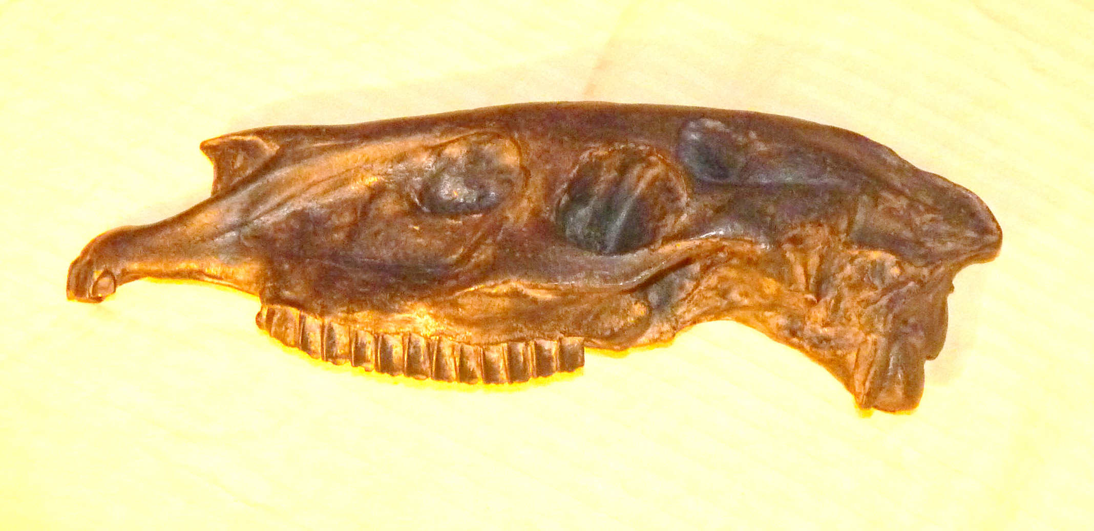
What does the geology and fossil record of the John Day Fossil Beds reveal about the climates and ecosystems of eastern Oregon’s past?
[In general, aridity increased, and landscapes transitioned from tropical forests to grasslands.]

Slide 6
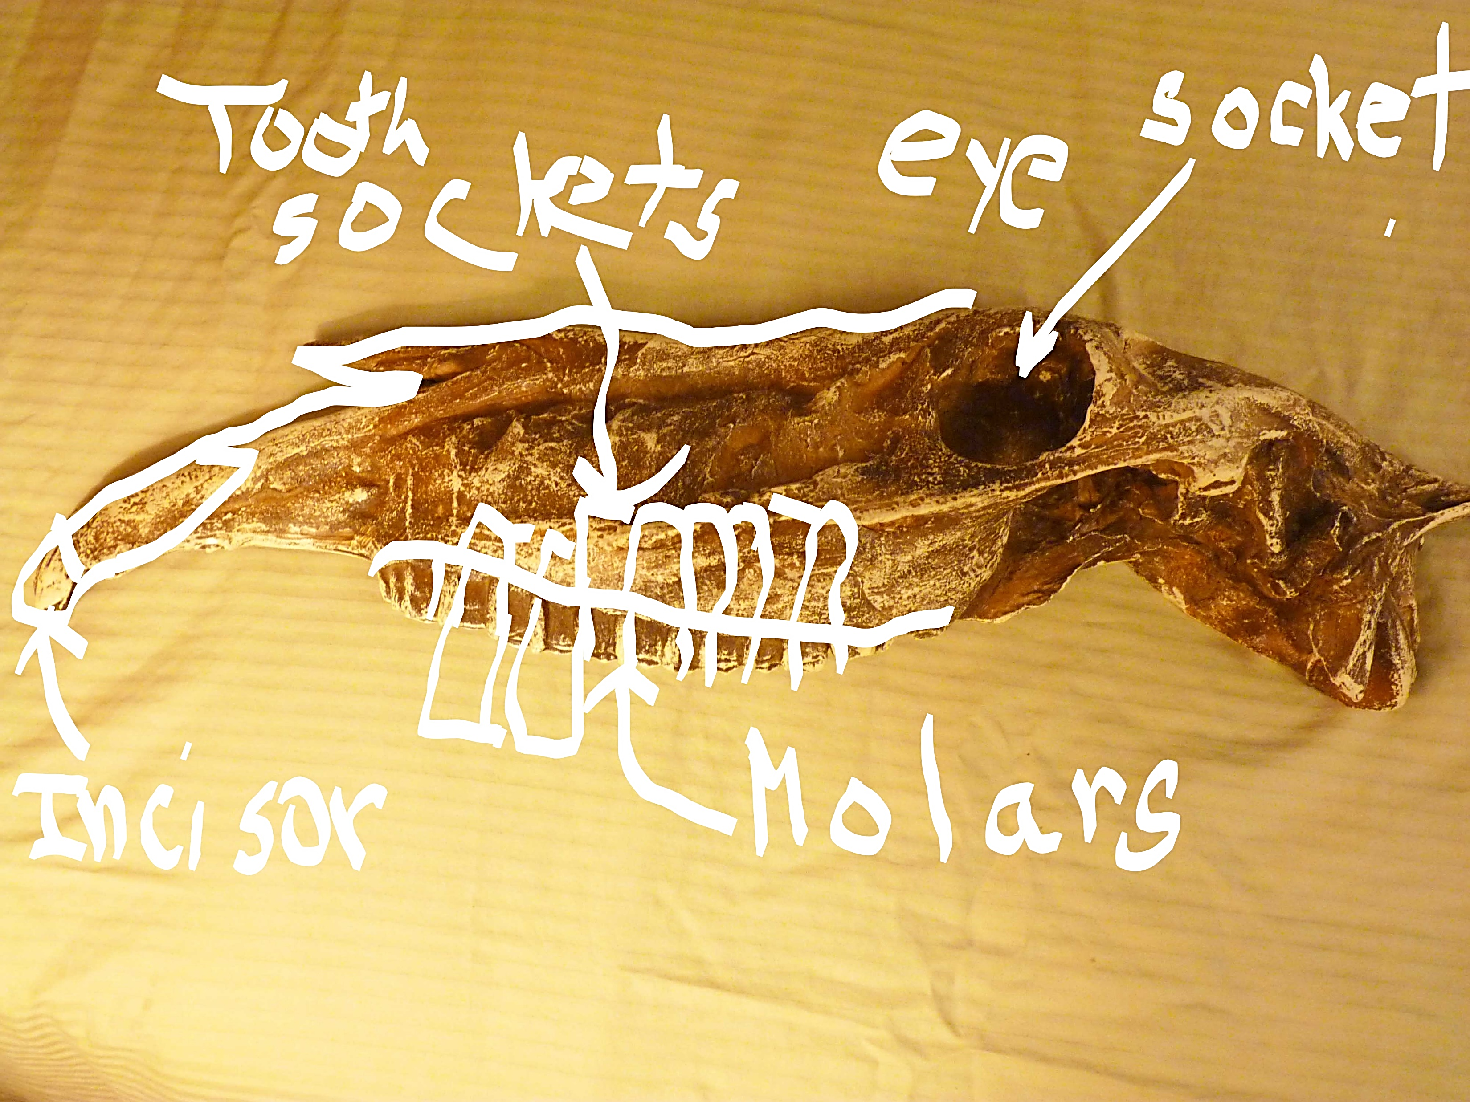
Let’s start by looking at skulls and teeth from the horse family. Pay attention to the position and height of the molars.

Slide 7
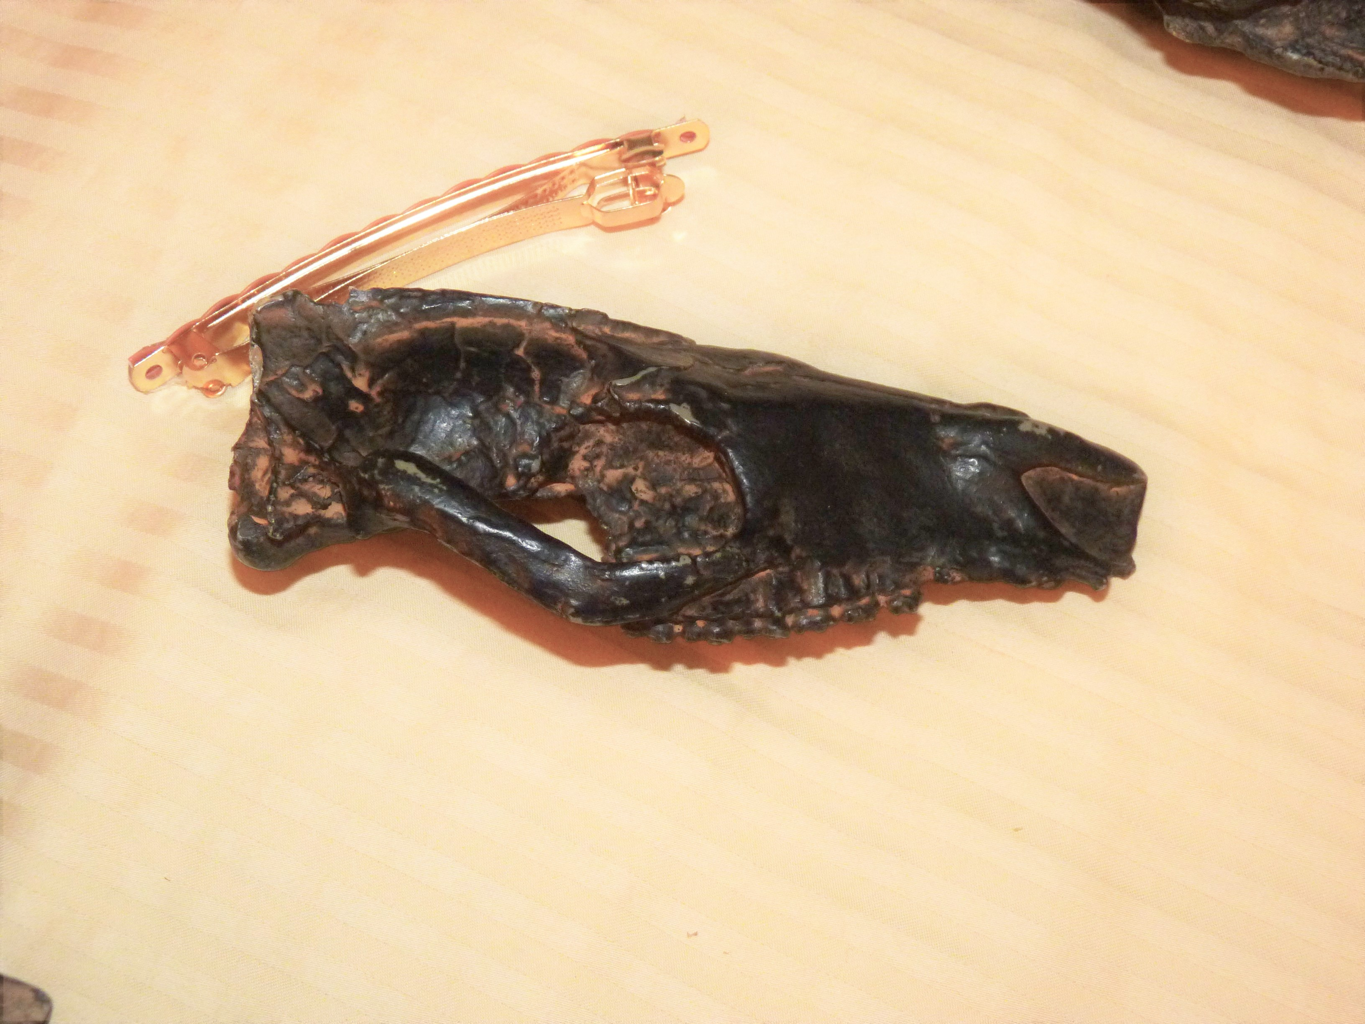
Find the intersection of anterior suborbital point with the mandible.
Notes:
Hyracotherium 55 mya

Slide 8
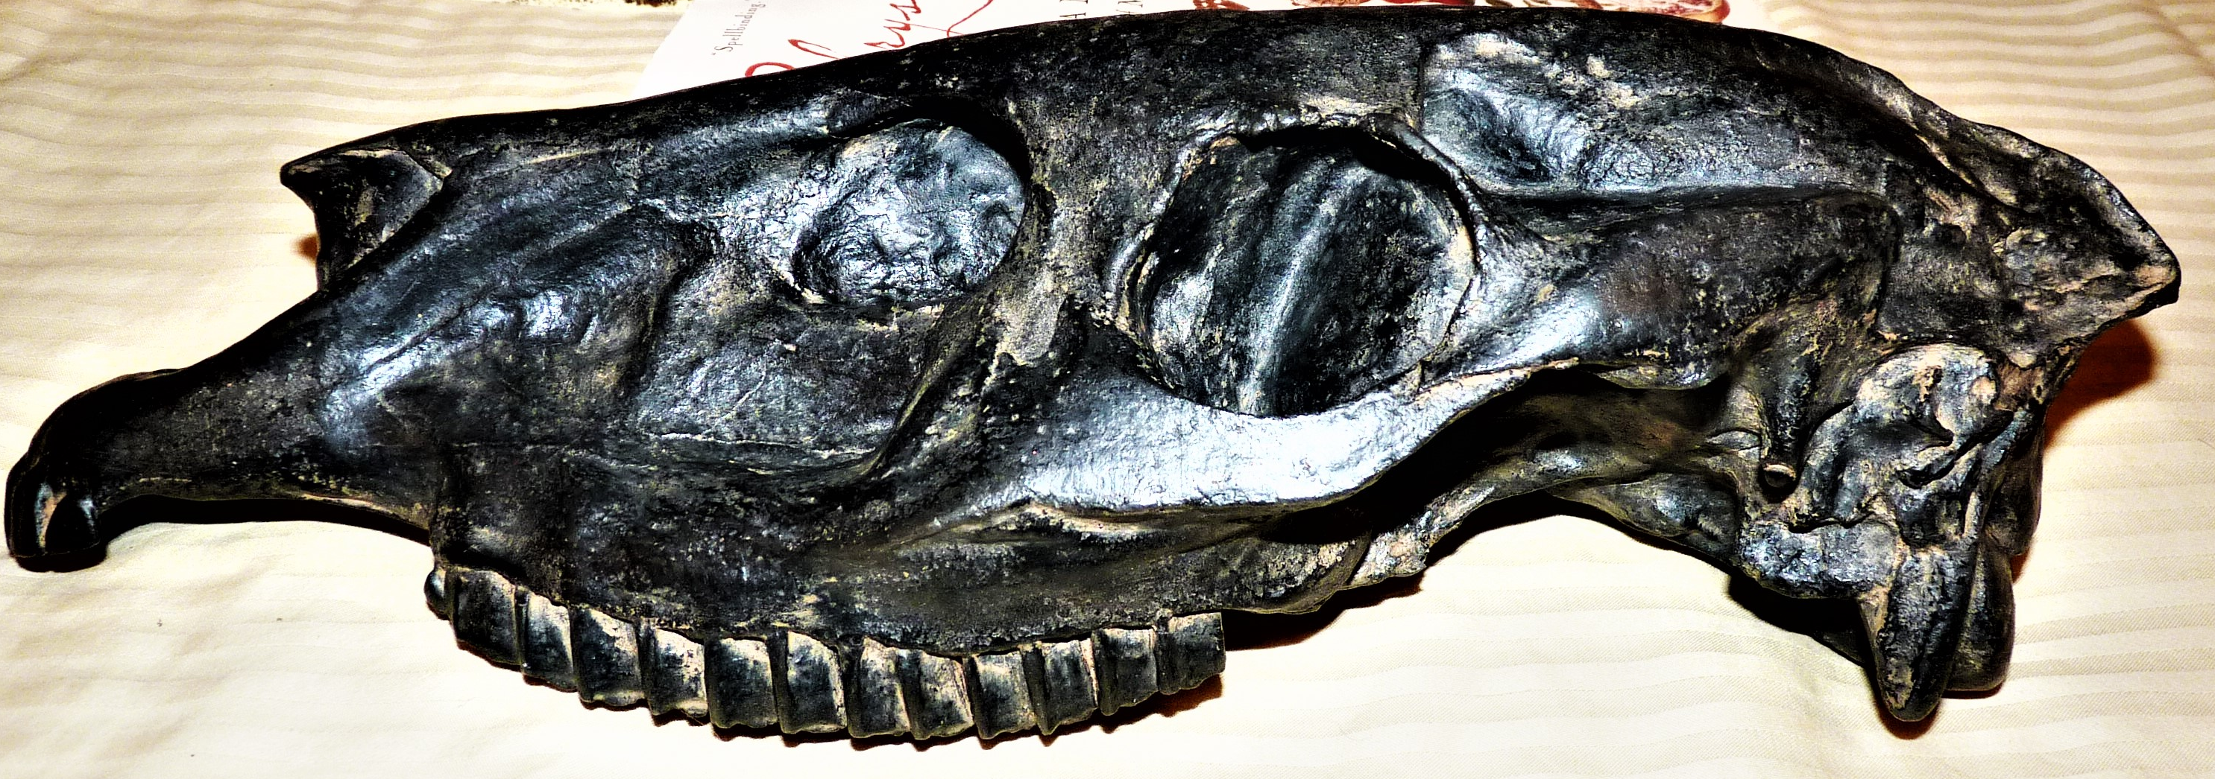
Find the intersection of anterior suborbital point with the mandible.
Notes:
Merychippus 16 mya

Slide 9
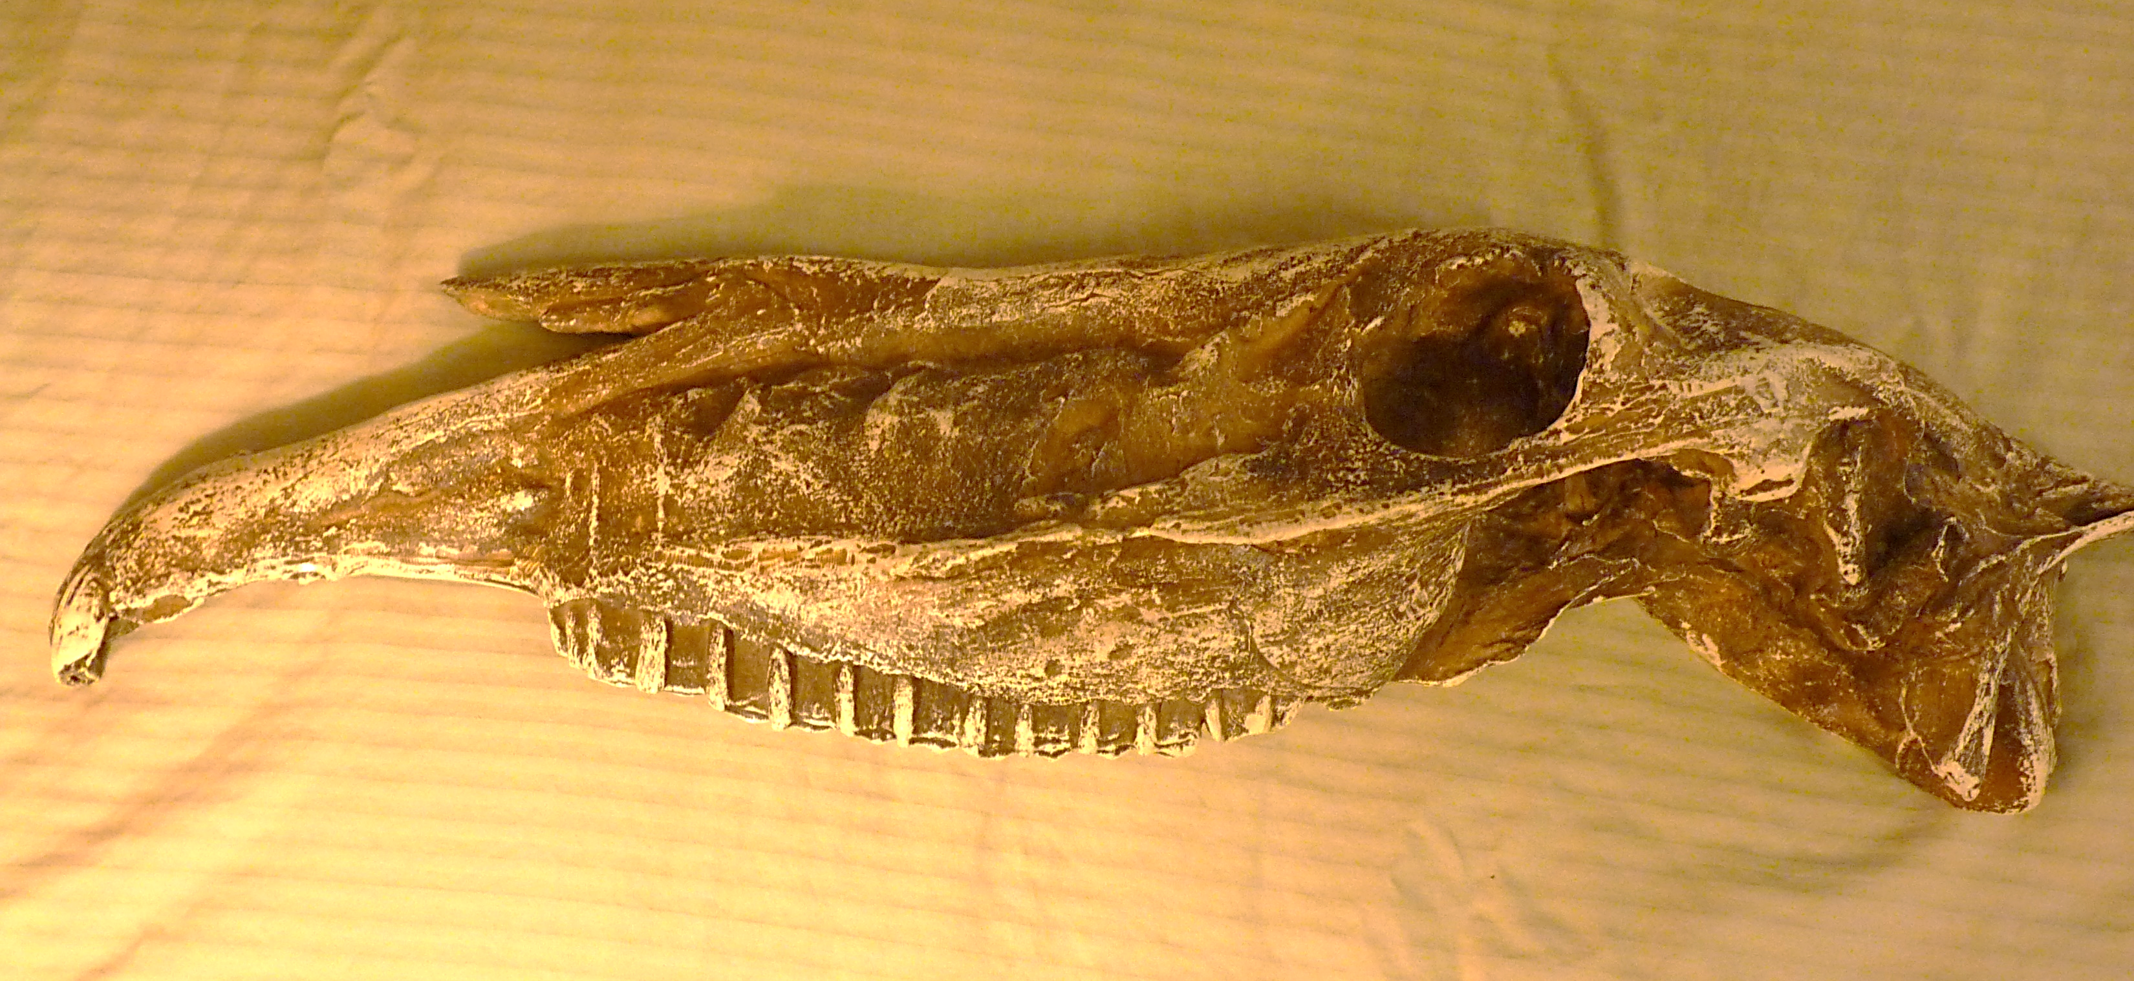
Find the intersection of anterior suborbital point with the mandible.
Notes:
Equus modern horse

Slide 10
55 mya
15 mya
present

Slide 11
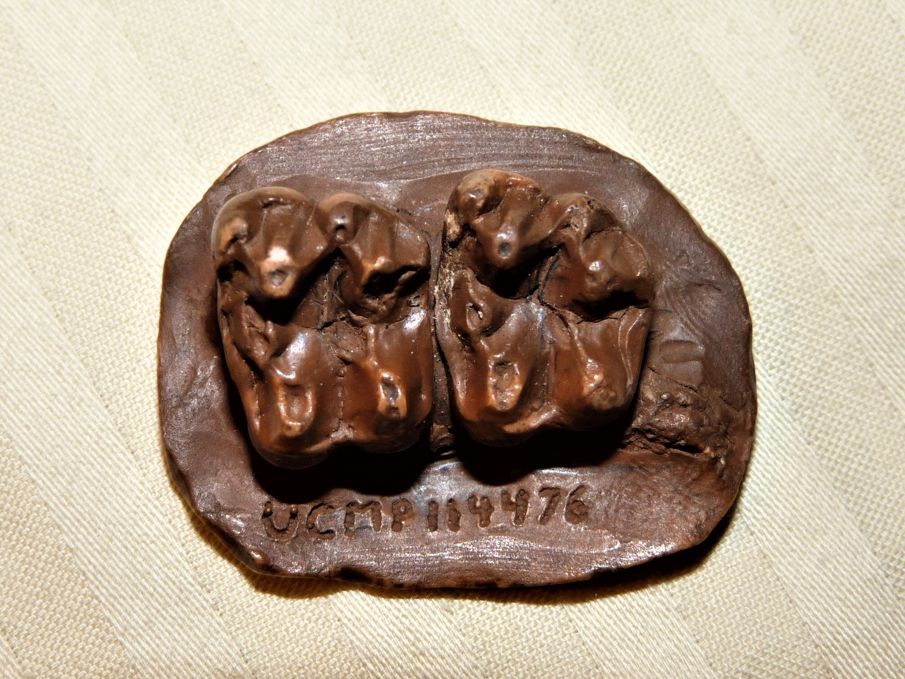
Notice the size, shape, and cusp pattern of these molars.
Notes:
Haplohippus 38 mya

Slide 12
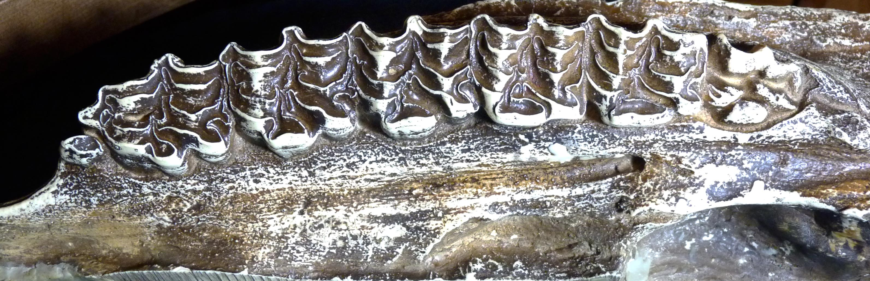
Notice the size, shape, and cusp pattern of these molars.
Notes:
Equus modern horse

Slide 13
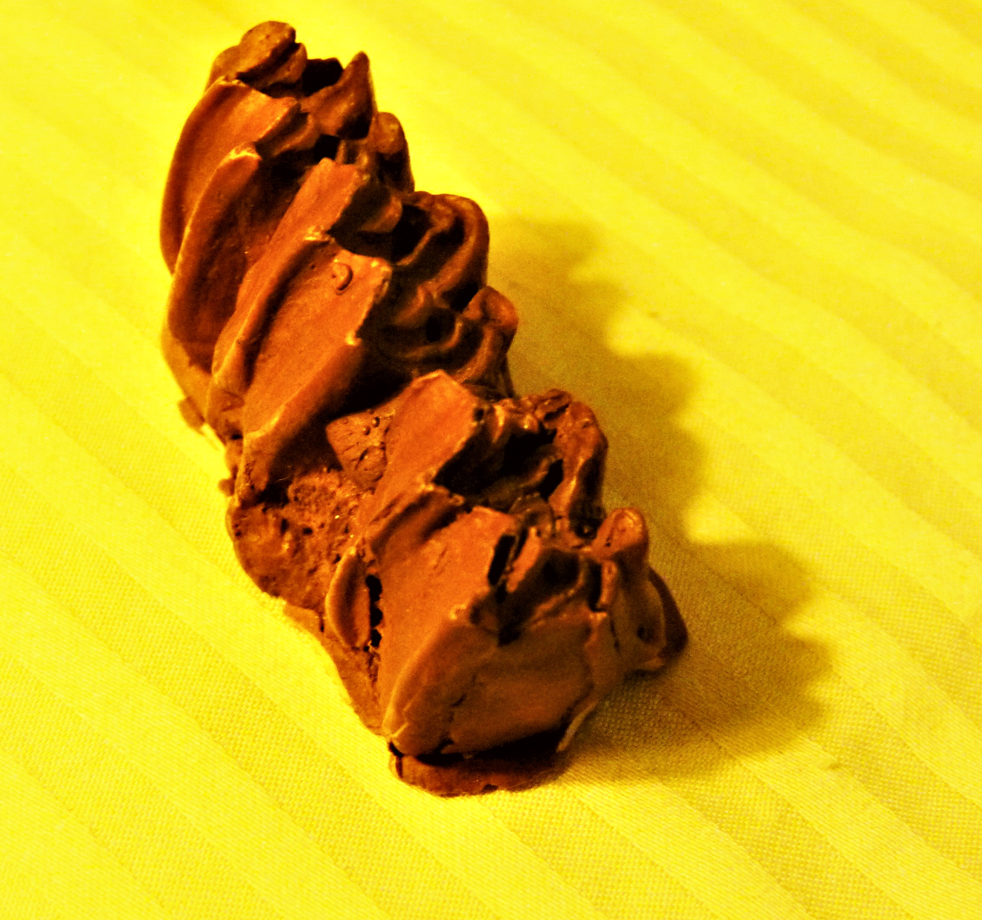
Notice the size, shape, and cusp pattern of these molars.
Notes:
Merychippus 16 mya

Slide 14
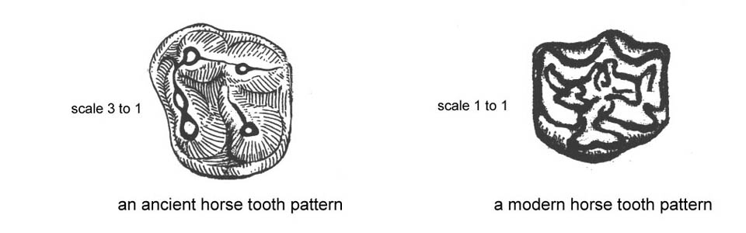

Slide 15
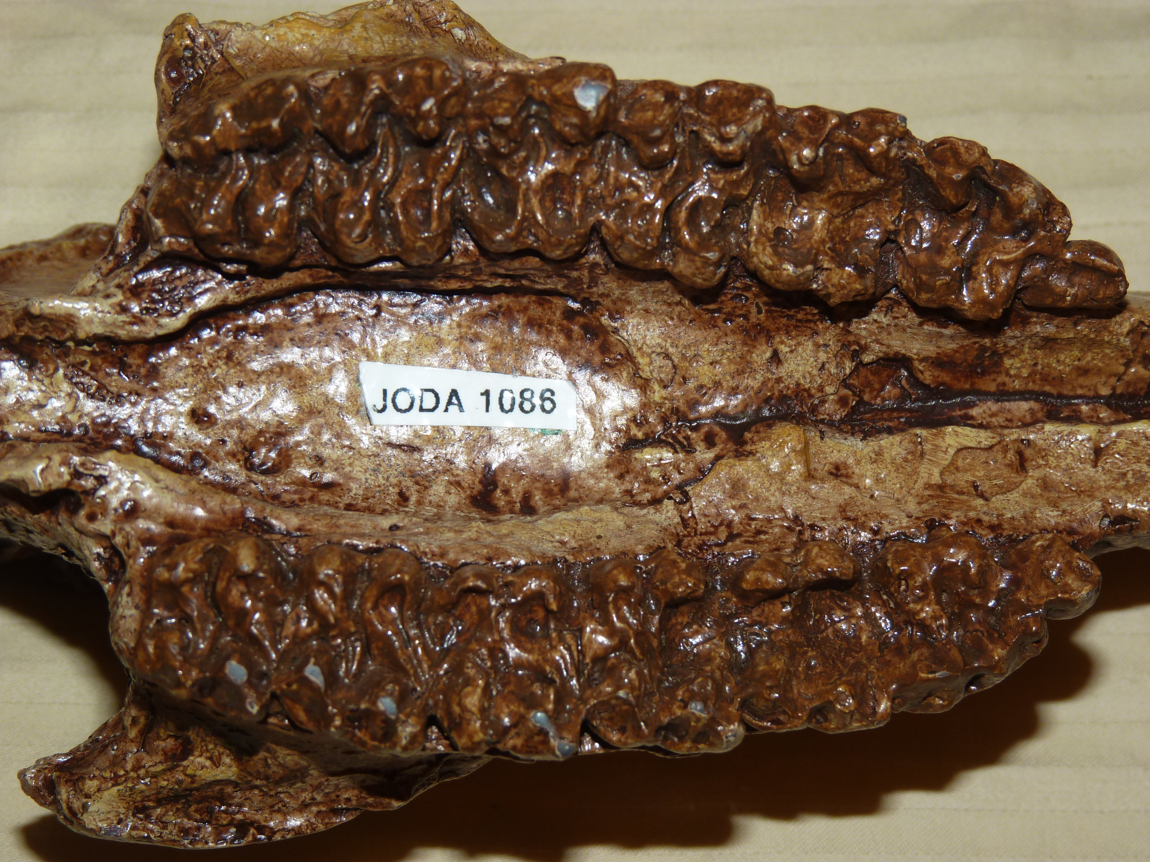
More ancient or more modern?
Notes:
Miohippus 27 mya JODA 1086

Slide 16
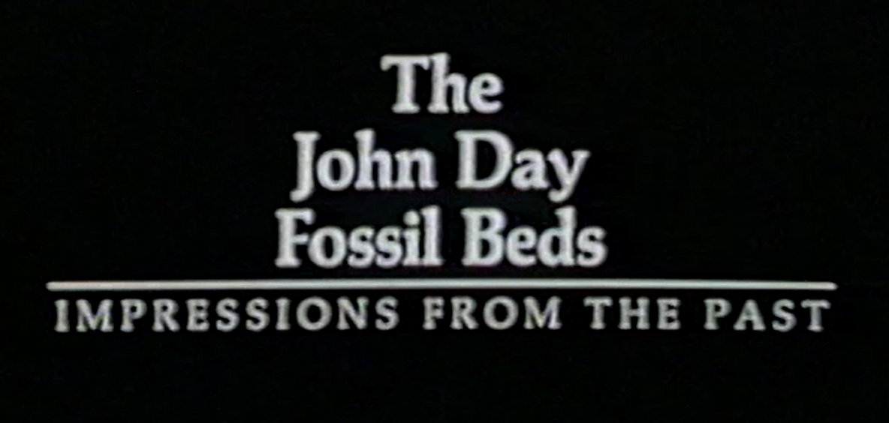
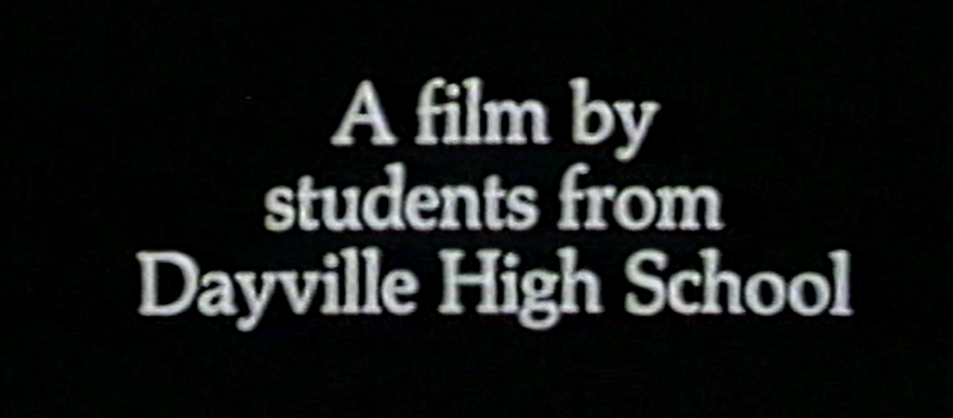

Slide 17
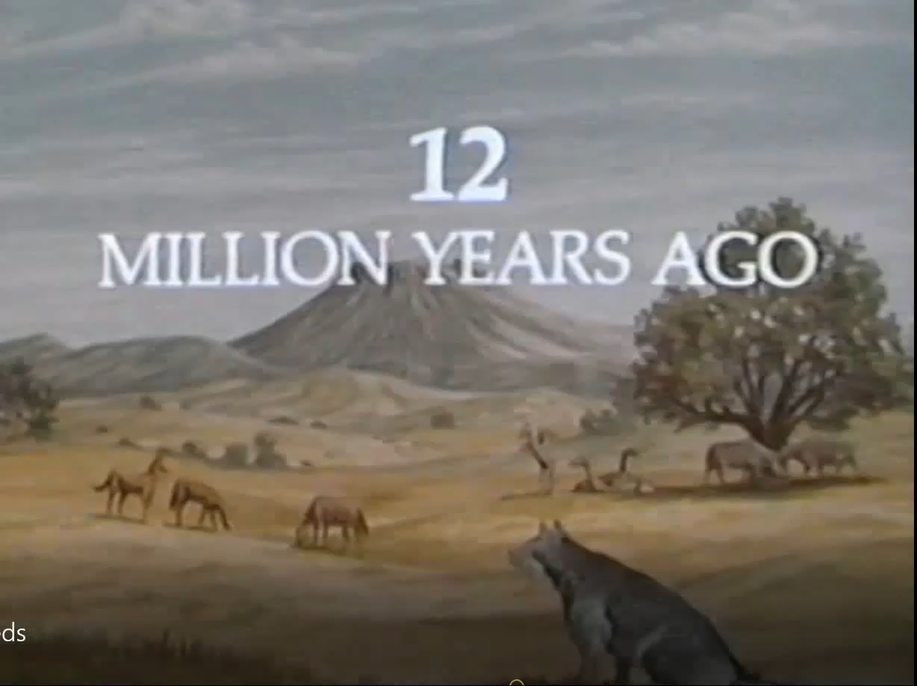

Slide 18
The “You Are What You Eat” lessons of the Horse Fossil Study Kit stress that horses are made from grass.

Slide 19

When Charles Darwin dug a fossil of a horse tooth out of a cliff in Argentina, he probably gave little thought to its chemistry. Modern climate scientists, however, treat fossil horse teeth (and skeletal bones) as Pleistocene thermometers.

Slide 20
The body rots away, but fossilized teeth may endure for millions of years, preserving the carbon isotope signature of their owner’s feeding habits.

Slide 21
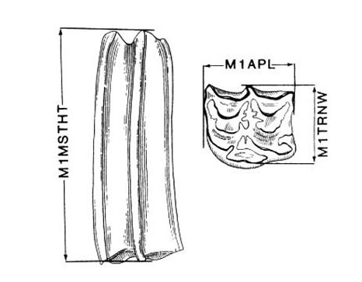
The teacher stands before the class with a horse fossil tooth in hand and says, “You are looking at a thermometer.”

Slide 22
What is the value of studying the fossil history of John Day Country?
Learning evolution through the lens of place: the quarries of the John Day Fossil Monument
Appreciating the nature of paleoclimatology: the challenge of inferring past habitats
Participating in community development:
the enhancement of tourism by welding a Plesiosaur

Slide 23
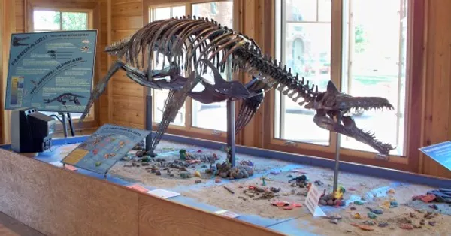
The Mitchell Plesiosaurus at the Oregon Paleolands Center, Fossil, OR
Notes:
Mitchell Plesiosaurus

Slide 24
What are the ends of place-based education?
Developing a just and sustainable society, democratically governed by a citizenry appreciative of the role of diverse bodies of knowledge.
Even a conventional unit on evolution can be repurposed to this end. The story of John Day fossils offers a promising start.

Slide 25
Place-based education configures subjects as strata of vivid, coherent stories in order to achieve socially valued ends.
Achieving a “sense of place” attaches the heart and mind to landscapes, the memories that inhabit them, and the promise of renewal.

Slide 26
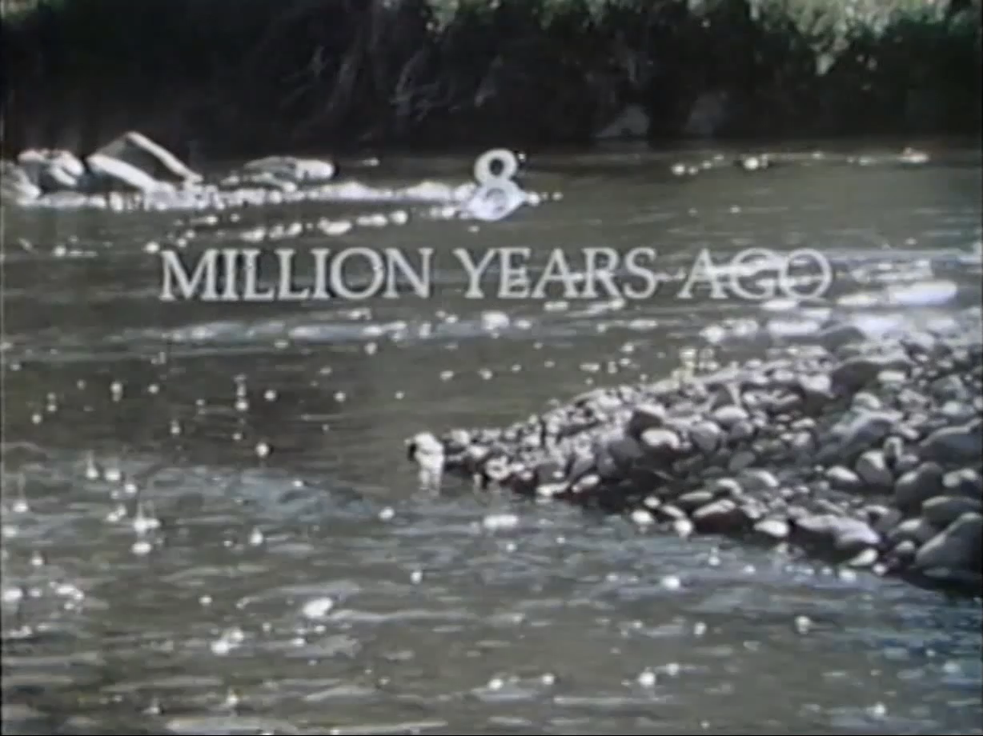

Slide 27
Elliot Eisner’s Criteria of Artistry:
> Vivid Depiction (the fossils)
> Universal in the Particular (inferring habitat)
> Coherence (place and time)
> Constructive Neglect (single species)

Slide 28
The Art of Place-based Education

